Slide 1

Cash Payment Inbound Design
Diyorbek Mukhammedov
2021.02.22

Slide 2
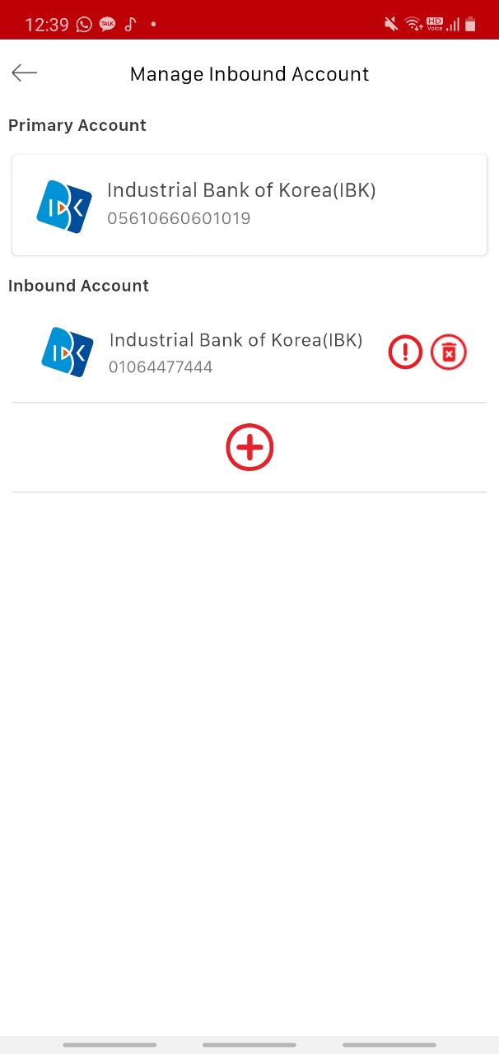
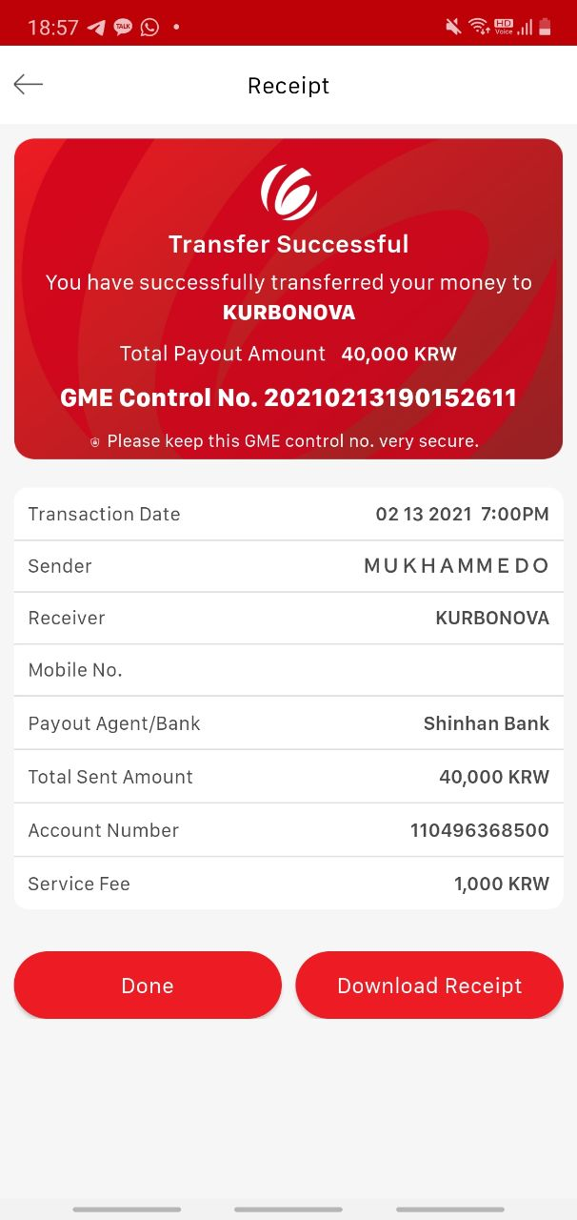
If Name Matches
IBK 056320321
Receiver Information
Name: DIYORBEK
Last Name: MUKHAMMEDOV
Phone Number: +821064477444
975234156_______
DO YOU CONFIRM TO DEPOSIT 1,126,820KRW TO IBK 0563123123
Sender: John Doe
Receiver: DIYORBEK MUKHAMMEDOV
Date: 2021.02.33
Time: 18.02
Amount received: USD1000
Exchange rate: 1USD = 1126.82 KRW
Control Number for Receiving
Please type in co number of the transaction
975234156
Confirm
Transaction: 975234156
Sender Name: John
Sender Last Name: Doe
Amount: USD1,000
Amount in KRW: 1,126,820KRW
* Current Exchange Rate 1USD = 1126.82 KRW
Confirm

Slide 3
If Name Does Not Match
Receiver Information
Name: DIYORBE
Last Name: MUKHAMMEDOV
Phone Number: +821064477444
ERROR:
Receiver name does not match for this transaction. Receiver name should be DIYORBEK MUKHAMMEDOV
Full name matches
Control Number for Receiving
Please type in co number of the transaction
975234156
Confirm
Confirm

Slide 4
Inbound User Flow
Receiver chooses Korona from the list of inbound partners
Search transaction using control number given by the sender
Name not matching
Error “Name does not match, real name is JOHN DOE, contact customer support”
Full name matches
Show all the information (Amount in USD, sender info and amount in KRW)
GME CS corrects the mistake and verifies from the system
Ask for confirmation and check a registered inbound account
Bank not registered
Ask customer to register a bank account
Bank account registered
Deposit the transaction and show transaction receipt

Slide 5
Name Verification
Need to check spelling of the full name to be 80% correct.
Should check spelling as a full name regardless of the order of first name or last name.
If incorrect, admin system should have the menu of failed to deposit inbound transactions.
Only show if control number exists
Only show if name did not match.

